Slide 1
BIG MOUNTAIN RESORT TICKET PRICE ANALYSIS
SELECTING BETTER VALUE FOR TICKET PRICES AND RAISING REVENUE
DAMILOLA EFUWAPE, MARCH 2021

Slide 2
Problem Identification
A recent facility improvement project increased Big Mountain Resort’s operation costs by $1,540,000. With likely limitations to charging a premium above market price to leverage this increase, the management has decided to capitalize on the resort’s facilities.
This can be done through reaching a better value for ticket price and cutting operation costs sizably which will, in turn, increase revenue by at least 25% by the end of the business year.

Slide 3
Big Mountain Resort currently charges 81 dollars. The analysis showed that, considering Big Mountain
's facilities, a modeled ticket price that could be supported in the Big
Recommendation and Key Findings
Mountain Resort currently charges 81 dollars. The analysis showed that, considering Big Mountain's facilities, a modeled ticket price that could be supported in
the marketplace is 95.87 dollars. The big difference between the modeled price and the current price charged shows how much the resort is undercharging.
After carefully considering each shortlisted option by the business, the following were concluded:
Closing the least-used runs provides varying levels of support for ticket pricing, the best of which is not making any difference at all, if only one run is closed.
Increasing the longest run by 0.2 miles would have no effect on the ticket price.
Adding a run to increase the vertical drop by 150 feet, and installing an additional chair lift would be the best possible scenario to aid a market-supported ticket price. Based on the assumption that each visitor buys an average of five day tickets, this suggested price raise will cover for the operating cost of the new chair, since customers tend to pay more for certain facilities and less for others.
Going further to add two acres of snow making would not make much difference either.

Slide 4
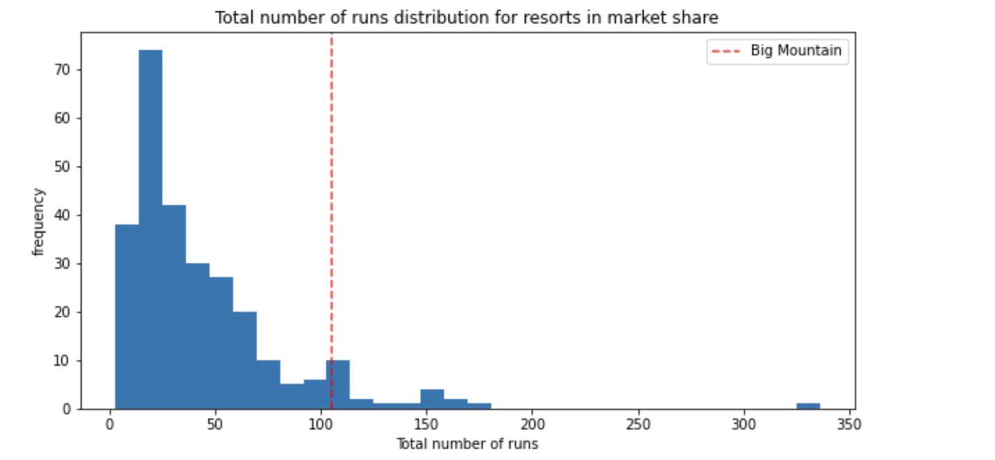
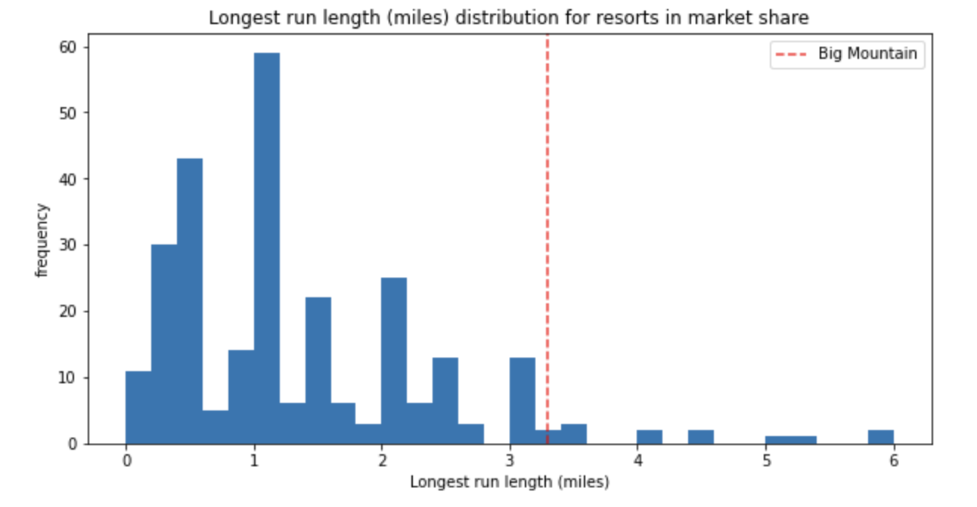
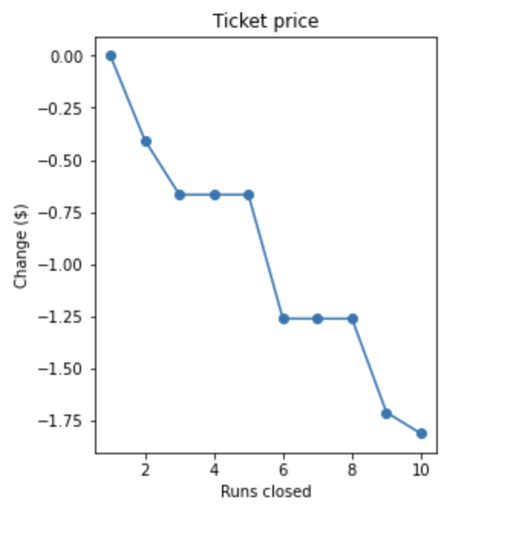
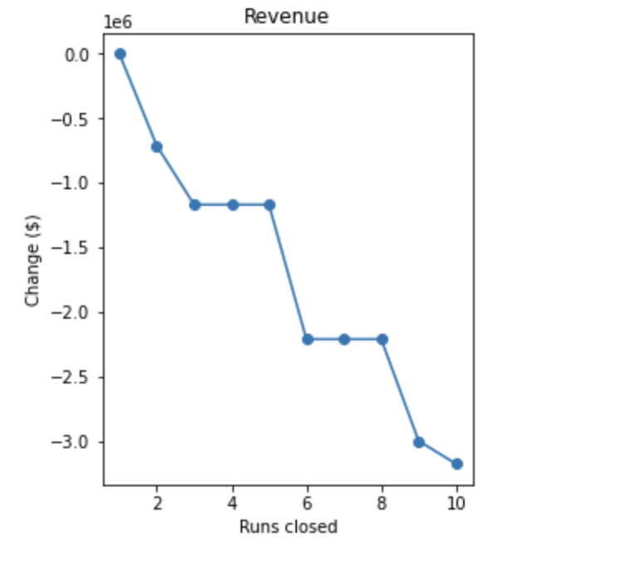
Modeling Results and Analysis
The project considered the number and length of runs Big Mountain has compared to other resorts in market share amongst other things and it discovered that only a few have more or longer. This is shown on the two graphs below:
It also looked at the relationship between runs closure and ticket prices. In particular, how closing a number of runs would affect ticket prices and then revenue.

Slide 5
The above graphs show that if only one run is closed, ticket prices and revenue remain the same, which would be the best scenario in terms of closing runs. If two runs are closed, there would be a drop in ticket prices and revenue. Dropping three would lead to a further drop, but the effect would be the same as closing four or five runs. This is the same for closing six, seven or eight runs and so on.
Overall, this option would lead to a decline in price support, which is not what the best outcome would be.
The analysis checked if the second option of increasing the longest run by 0.2 miles would cause an increase in ticket prices and revenue, but found that it would have a zero effect.

Slide 6
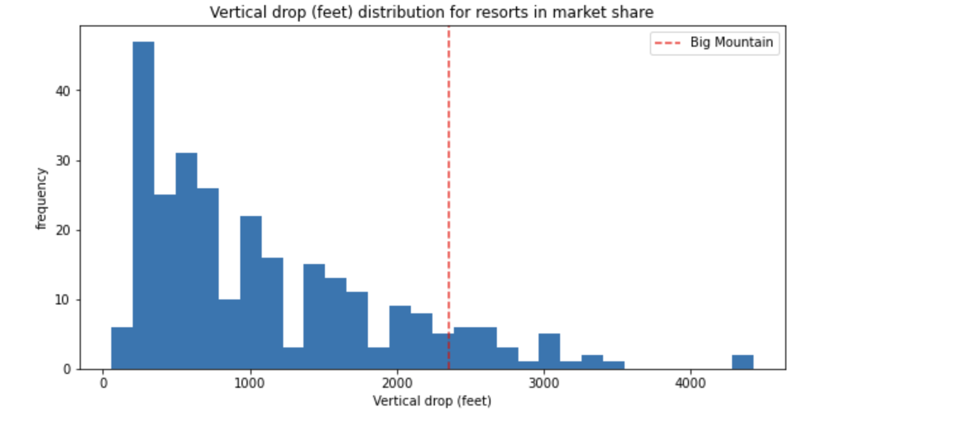
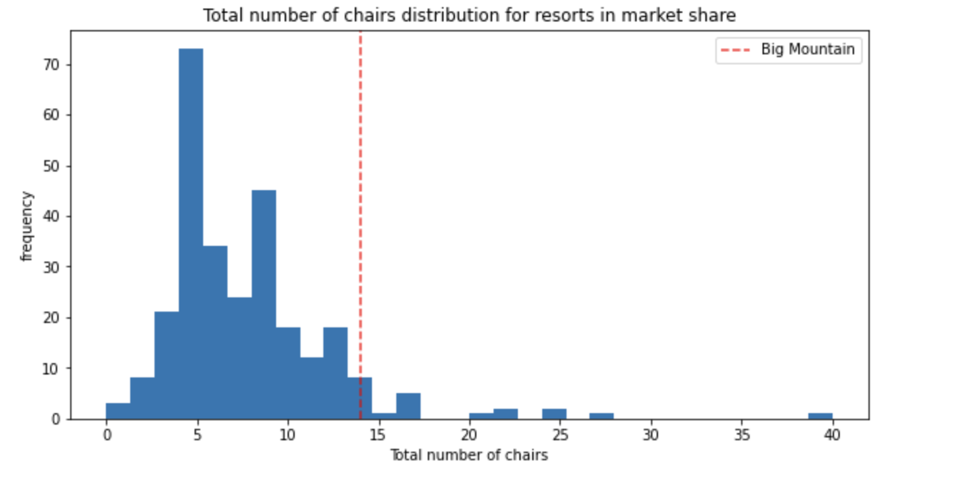
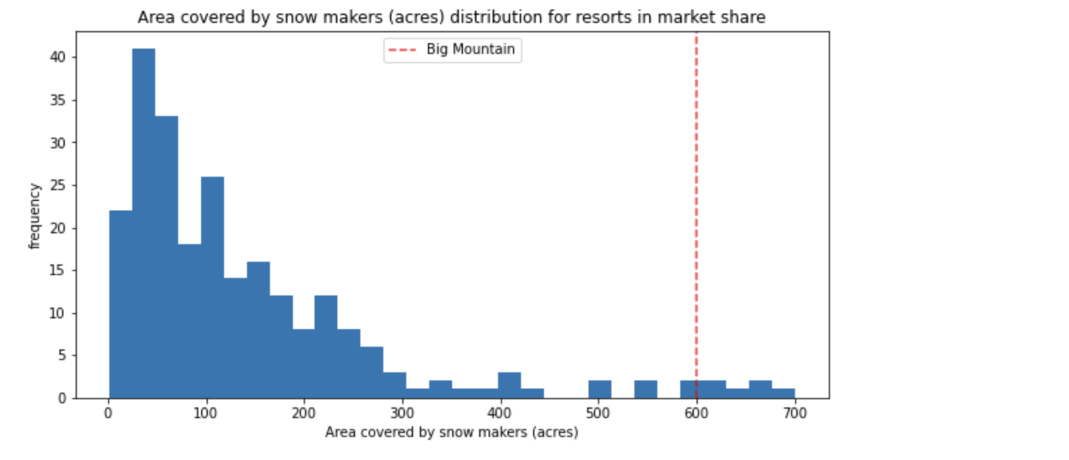
Big Mountain ranks among the top resorts with best vertical drop and highest number of chairs as shown in the graph below, but how about improving a little on these?
This option of adding a run, increasing the vertical drop by 150 feet, and installing an additional chair lift, which the project found would increase support for ticket price by $1.99, adding up to about $3,474,638 over the whole season, would be the best.
But, adding two acres of snow making to this would only be a waste of resources because it would not make much difference and Big Mountain is already among the resorts with the highest snow making area as shown below:

Slide 7
Summary and Conclusion
Overall, the project looked at ways that Big Mountain Resort can take advantage of its facilities by reaching a better ticket value and sizably cutting down on operation costs.
Weekday and weekend ticket prices were considered in predicting ticket prices, but weekend was then chosen as the preferred feature because it contained fewer missing values than the weekday prices feature.
It was then determined that adding a run to increase the vertical drop by 150 feet, and installing an additional chair lift would be the best possible way to aid a market-supported ticket price. While this may seem like accruing additional operating cost, the suggested price raise would cover the cost, assuming each customer buys an average five day ticket, because this is one of the facilities that supports a given ticket price and customers would pay more for it as a result of the satisfaction they get.

